Slide 1

Avkash Chauhan (avkash@h2o.ai)
VP, Enterprise Customers

Slide 2
Agenda
H2O Intro
Installation
Using H2O from FLOW, R & Python
Data munging in H2O with Python
2 examples of machine learning problems
GBM, GLM, DRF
Understanding Models, improvements,
Machine learning production pipeline
H2O.ai is a Visionary in the Gartner Magic Quadrant
for Data Science Platforms

Slide 3
Introduction & Overview

Slide 4
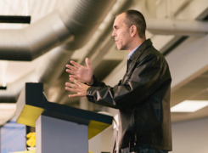
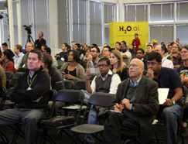
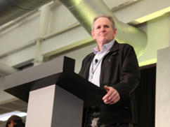
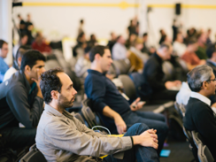
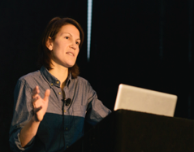
H2O.ai Company Overview
Founded | 2011 Venture-backed, debuted in 2012
Products | H2O Open Source In-Memory AI Prediction Engine Sparkling Water STEAM DEEP WATER
Mission | Operationalize Data Science, and provide a platform for users to build beautiful data products
Team | 60+ employees worldwide CA, NY, UT, Japan, UK Distributed Systems Engineers doing Machine Learning World-class visualization designers
Headquarters | Mountain View, CA

Slide 5
Please visit: http://www.h2o.ai/customers/#
H2O Users List: http://www.h2o.ai/user-list/

Slide 6


Customers and Use Cases
Financial
Telecom
Insurance
Healthcare
Marketing

Slide 7
Open Source Users & Community
H2O Users List: http://www.h2o.ai/user-list/

Slide 8
About Myself
VP – Enterprise products & customers
Handling paid enterprise customer’s requirements
building product(s)
Helping community
LinkedIn: https://www.linkedin.com/in/avkashchauhan/
Blog: https://aichamp.wordpress.com/
Community: https://community.h2o.ai/index.html
Twitter: @avkashchauhan

Slide 9
Products and Features
Q

Slide 10


H2O Platform(s)
DEEP WATER
In-Memory, Distributed Machine Learning Algorithms with H₂O Flow GUI
H2O AI Open Source Engine Integration with Spark

Slide 11
Key features
Open Source (Apache 2.0)
All supported ML algorithms are coded by our engineers
Designed for speed, scalability and for super large data-sets
Same distribution for open source community & enterprise
Very active production, every other week release
Vibrant open source community
https://community.h2o.ai
Enterprise Support portal
https://support.h2o.ai
We have 70,000 users, 8,000 organizations and growing daily

Slide 12
Usage: Simple Solution
Single Deployable compiled Java code (jar)
Ready to use point and click FLOW Interface
Connection from R and Python after specific packages are installed
Use Java, Scala natively and any other language through RESTful API
Deployable models - Binary & Java (POJO & MOJO)
One click prediction/scoring engine

Slide 13
Usage: Complex Solution
Multi-node Deployment
Spark and Hadoop distributed environment
Sparkling Water (Spark + H2O)
Data ingested from various inputs
S3, HDFS, NFS, JDBC, Object store etc.
Streaming support in Spark (through Sparking Water)
Distributed machine learning for every algorithm in platform
Prediction service deployment on several machines

Slide 14
Current Algorithm Overview
Statistical Analysis
Linear Models (GLM)
Naïve Bayes
Ensembles
Random Forest
Distributed Trees
Gradient Boosting Machine
R Package - Stacking / Super Learner
Deep Neural Networks
Multi-layer Feed-Forward Neural Network
Auto-encoder
Anomaly Detection
Clustering
K-Means
Dimension Reduction
Principal Component Analysis
Generalized Low Rank Models
Solvers & Optimization
Generalized ADMM Solver
L-BFGS (Quasi Newton Method)
Ordinary Least-Square Solver
Stochastic Gradient Descent
Data Munging
Scalable Data Frames
Sort, Slice, Log Transform
Data.table (1B rows groupBy record)

Slide 15
Technical Architecture
Q

Slide 16
















Core H2O: Architecture
Production
Environments
REST / JSON
HDFS
Parse
Exploratory
Analysis
ML
Algorithms
Scoring
POJO
S3
Feature
Engineering
Model
Evaluation
Data/Model
Export
Local
Fluid Vector Frame
Job
NFS
Distributed K/V Store
MRTask
Non-Blocking Hash Table
Distributed Fork/Join
SQL
Distributed In-Memory Processing

Slide 17
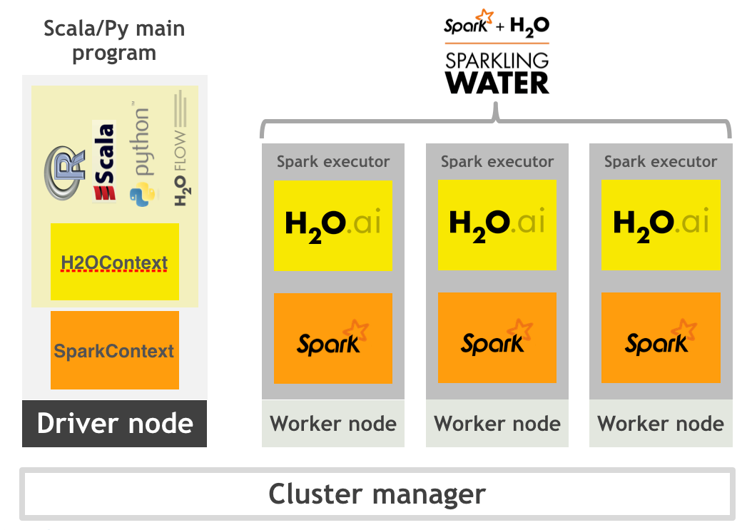
Sparkling Water - High Level Architecture

Slide 18

Deep Water : Architecture
R/Py/Flow/Scala client
REST API
Web server
H₂O Java
Execution Engine
RPC
H₂O Java
Execution Engine
Scala Spark
Scala Spark
grpc/MPI/RDMA
TensorFlow/mxnet/Caffe
C++
TensorFlow/mxnet/Caffe
C++
GPU
CPU
GPU
CPU
Node 1
Node N

Slide 19
H2O Installation
Q

Slide 20
What we covered with H2O Installation
Installation, using H2O with R & Python
Installation H2O
Help – help(h2o.init), h2o.cluster_status()
H2O Github repo
Source code - glance
R package installation
Python Package Installation
Connecting H2O from R
Connecting H2O from Python
Q

Slide 21
H2O FLOW DEMO
Q

Slide 22
What we covered in FLOW DEMO
FLOW Intro
Running Examples
Generating Data
Working with UI, Cell, Running FLOW Script
Importing Data
Chunk Distribution
Feature analysis
Building models from imported data
Understanding models
Binary Model, POJO, MOJO
Listing all Jobs
Using HELP
Understanding RESTful Interface
Reading Logs, Water Meter (CPU analysis), Stack Trace etc.
Q

Slide 23
Data manipulation between H2O, R & python
Q

Slide 24
Data manipulation between H2O, R, python
Import data in between H2O, python, R and others..
H2O
R, python, Java, Scala, etc..
360⁰ View
Q

Slide 25
Data manipulation between H2O, R, python
Part 1
Import data in python
import pandas as pd
datasetpath = "/Users/avkashchauhan/tools/datasets/kaggle-imdb-word2vec”
train_data = pd.read_csv(datasetpath + "/labeledTrainData.tsv", header=0, delimiter="\t", quoting=3)
h2o.ls()
train_data.describe()
train_data_h2o = h2o.H2OFrame(train_data, destination_frame = "train_data_h2o")
h2o.ls()
train_data_h2o.describe()
Now Look the same frame in the FLOW - getFrames
In R
> h2o.ls()
> rdf = h2o.getFrame("train_data_h2o")
> rdf
> summary(rdf)
Q
Reference: http://localhost:8888/notebooks/H2O-start-test-and-data-switch-python-r.ipynb

Slide 26
Data manipulation between H2O, R, python
Part 2
Import data in R
> iris
> mydf = as.h2o(iris)
This frame will be imported as iris original frame name
> summary(mydf)
> summary(iris)
> h2o.ls()
You will see the iris entry as h2o frames list
Check FLOW as well and you will see iris there too
> mydf = as.h2o(iris, destination_frame = “mydf”)
> h2o.ls()
In Python
h2o.ls()
my_python_df= h2o.get_frame("mydf")
my_python_df
h2o.ls()
Q

Slide 27
Data munging in H2O with Python
Q

Slide 28
What we covered Data munging in H2O with python
H2O and Python
Jupyter notebook Demo
Data import
Row, column, data frames, slicing, binding, exporting, factoring
Using functions
Reference:
[1] http://localhost:8888/notebooks/H2O%20Data%20Ingest%20Demo.ipynb
Q

Slide 29
What we covered
Data Import
Understood data, frame distribution, chunk, compression etc.
Understood all features, through histograms, enums, etc.
Split data frames for train and test
Converting features to Factors/Enum
Imputation of values
Training
with Training frame only
With cross-validation
with validation frame
Understanding Model details
Documentation
http://docs.h2o.ai/h2o/latest-stable/h2o-docs/index.html

Slide 30
R - Demo
Start R
> h2o.init()
> h2o.clusterStatus()
?h2o.gbm > Use the sample
> h2o.varimp(gbm)
> h2o.varimp_plot(gbm)
Performance
> perf <- h2o.performance(gbm, australia.hex)
> h2o.mse(perf)
> h2o.r2(perf)
Add CV – Rebuild the model with nfolds = 5
> h2o.cross_validation_models(gbm)
Kmeans - ?h2o.kmeans
Run the example
Want to eval the K?
kmodel = h2o.kmeans(training_frame = prostate.hex, k = 10, x = c("AGE", "RACE", "VOL", "GLEASON"))
kmodel = h2o.kmeans(training_frame = prostate.hex, k = 100, x = c("AGE", "RACE", "VOL", "GLEASON"), estimate_k = T)

Slide 31
Supplement Information
https://www.kaggle.com/harlfoxem/d/harlfoxem/housesalesprediction/house-price-prediction-part-1/discussion
https://www.kaggle.com/auygur/d/harlfoxem/housesalesprediction/step-by-step-house-price-prediction-r-2-0-77/code
https://rpubs.com/MagicSea/property_price

Slide 32
Solving a Binomial Classification problem
Q

Slide 33
Binomial Classification Problem Description
Titanic Survivors list
Passengers on board: 1317, others were crew of total 2224
Kaggle
https://www.kaggle.com/c/titanic
Download Dataset:
http://biostat.mc.vanderbilt.edu/wiki/pub/Main/DataSets/titanic3.xls
Local Datasets
/Users/avkashchauhan/learn/seattle-workshop/titanic_list.csv
Documentation
http://docs.h2o.ai/h2o/latest-stable/h2o-docs/index.html

Slide 34
Predicting Titanic Survival Rate
Reference:
Using scikit-learn
http://localhost:8888/notebooks/Titanic%20Survival%20Demo%20in%20Python.ipynb
Using H2O python estimators
http://localhost:8888/notebooks/Titanic%20Survival%20Demo%20in%20H2O%20and%20Python.ipynb

Slide 35
What we learn– ROC Curve
AUC of 0.5 is random and 1 is perfect

Slide 36
What we did
GLM/GBM/RF in Python + scikit-learn
GLM in H2O from Python
Grid Search
Working in FLOW
Ingest, split frame
GLM in H2O from FLOW
Response must be number
Understanding r2
GBM in FLOW
Response numeric– Regression
r2
Response enum – classification
AUC (Area under the curve)
Confusion matrix
ROC Curve – NEXT PAGE
AUC
AUC of 0.5 is random and 1 is perfect
Improve AUC

Slide 37
What we covered
Data Import
Understood data, frame distribution, chunk, compression etc.
Understood all features, through histograms, enums, etc.
Split data frames for train and test
Converting features to Factors/Enum
Imputation of values

Slide 38
Thank you so much
Notes:
Koeidesu

